Slide 1
Big Data Project
Team Members
Khaled Said Badawy Shebl, Section: 2
Hussein Ata Hussein, Section: 2
Ahmed Sahrawy Shehata, Section: 1
Abanon Amin, Section: 1
David Mounir, Section: 2
Under Supervision
Dr. Sherine Rady
TAs: Mariam Mohamed
Hazem Marwan

Slide 2
Dataset Description
A listing of each accidental death associated with drug overdose in Connecticut (Connecticut is the southernmost state in the New England region of the United States) from 2012 to 2018.
Data are derived from an investigation by the Office of the Chief Medical Examiner which includes the toxicity report, death certificate.

Slide 3
Phase 1 : Discovery
Main problem: People takes different drugs and the actual reason of death is not correctly identified.
Data: Accidental Drug Related Deaths 2012-2018 data set.
Objective: Help doctors to know accidental drug related deaths.
Initial Hypotheses: H0: Manner of death is accident.
H1: Manner of death is pending.
H2: Manner of death is natural.

Slide 4
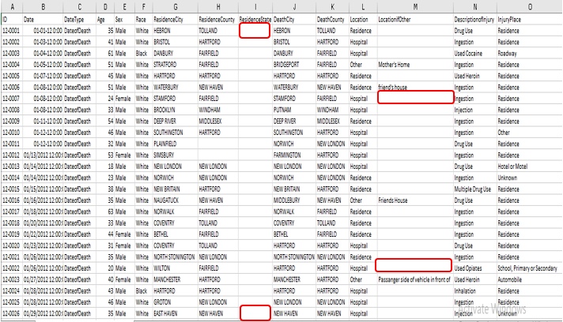
Phase 2 : Data Preparation Data Preprocessing
Replace null values

Slide 5
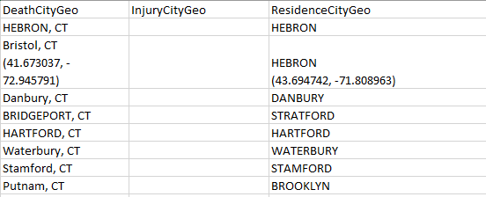
Phase 2 : Data Preparation(Cont.) Data Preprocessing
Delete columns that have nothing to do with our goal.

Slide 6
Phase 2 : Data Preparation(Cont.) Data Preprocessing
Delete rows that have (ResidenceCity or DeathCity) are null because our goal is to study accidents because of drugs based on location which is not available at those rows
.

Slide 7
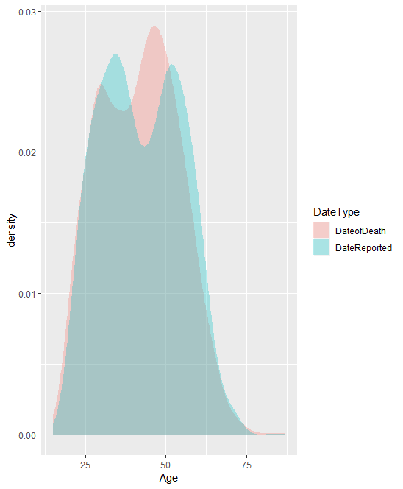
Phase 2 : Data Preparation(Cont.) Data Visualization
Detect relation between age and Date type.
People who are between (45-50) are die because of drugs.

Slide 8
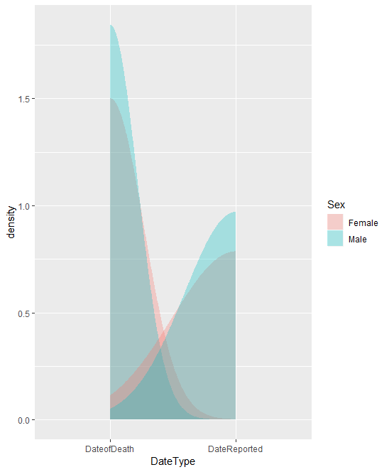
Phase 2 : Data Preparation(Cont.) Data Visualization
Detect relation between sex and date type.
Number of males who die because of drugs are greater than number of females.

Slide 9
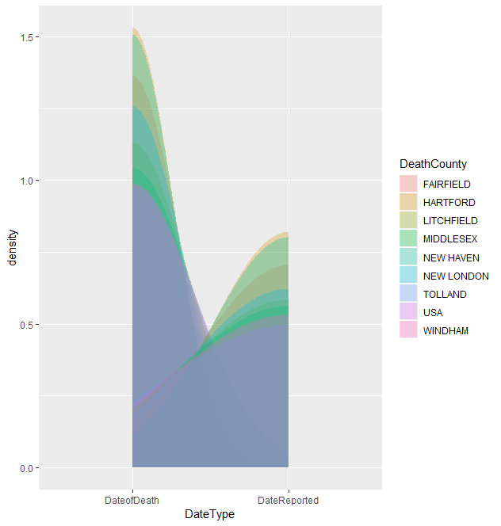
Phase 2 : Data Preparation(Cont.) Data Visualization
Detect relation between date type and country.
HARTFORD Country have the highest number of people who die because of drugs.

Slide 10
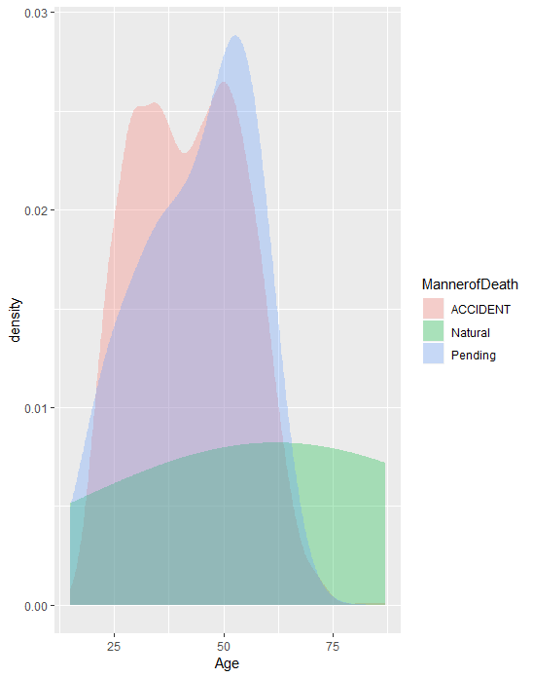
Phase 2 : Data Preparation(Cont.) Data Visualization
Detect relation between age and manner of death.
People who are between (50-55) years old die during taking drugs.
People who are between ((30-35) , (47-52)) years old die because of accidents related to drugs.

Slide 11
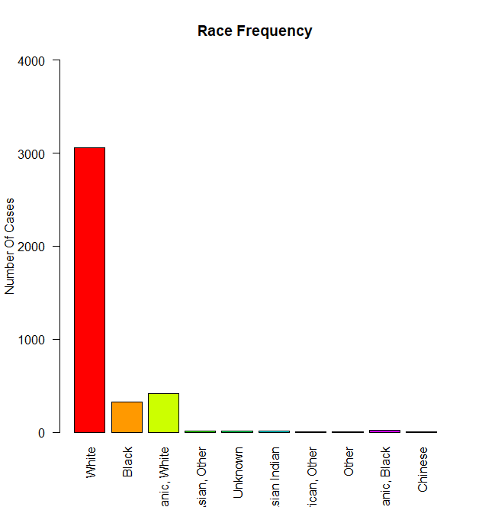
Phase 2 : Data Preparation(Cont.) Data Visualization
Detect race of the highest number of people that taking drugs
White people are the most people that takes drugs.

Slide 12
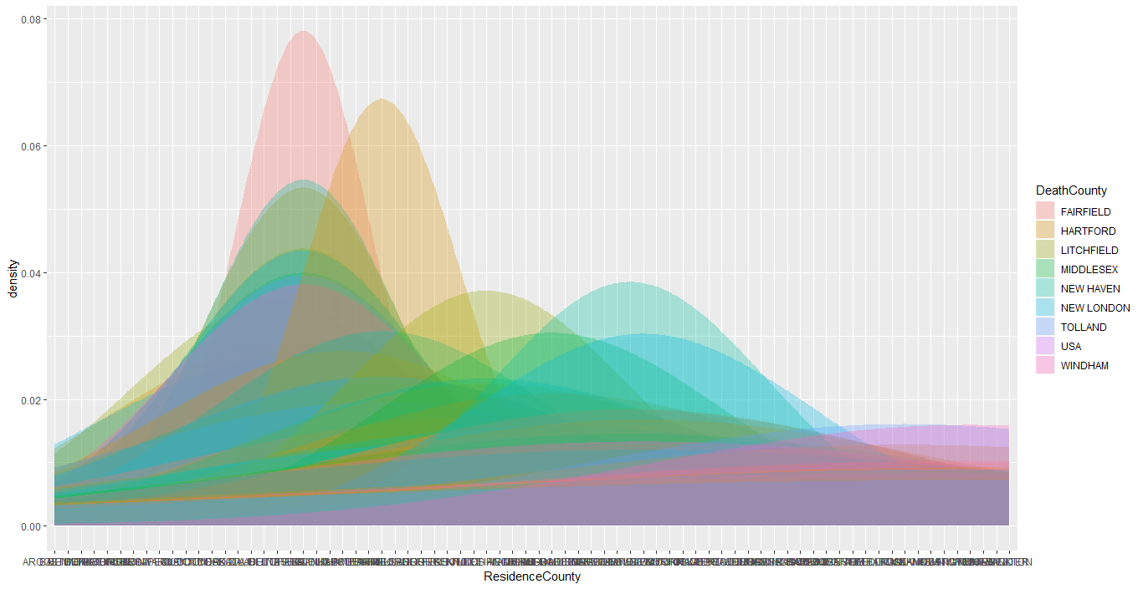
Phase 2 : Data Preparation(Cont.) Data Visualization
Detect relation between resident country and death country.
The highest country that is resident count and death country at the same time is (HARTFORD).

Slide 13
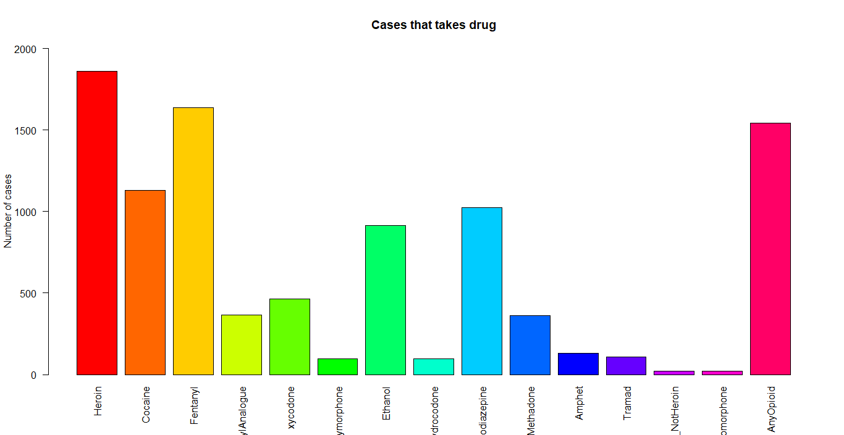
Phase 2 : Data Preparation(Cont.) Data Visualization
Determine what type of drug that is most taken.
The most used drug is (Heroin then Any Opioid).

Slide 14
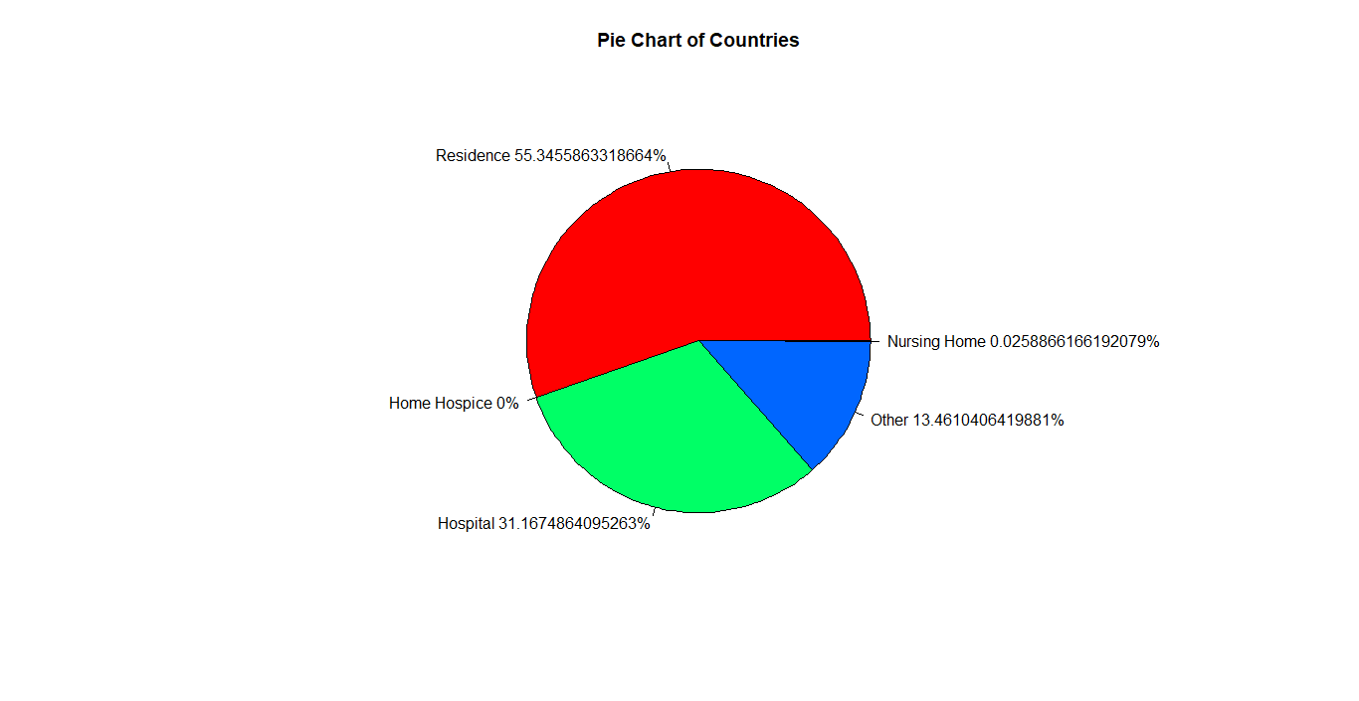
Phase 2 : Data Preparation(Cont.) Data Visualization
Determine percentage of each location that person die in.
Most of people that takes drugs die in residence location.

Slide 15
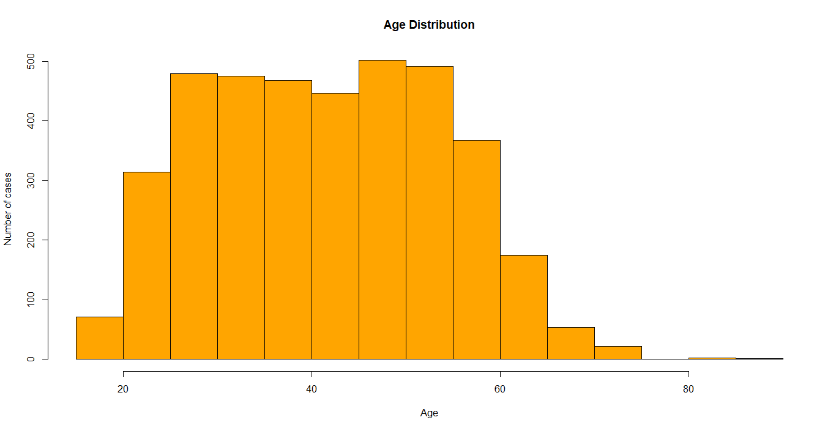
Phase 2 : Data Preparation(Cont.) Data Visualization
Know distribution of age.

Slide 16
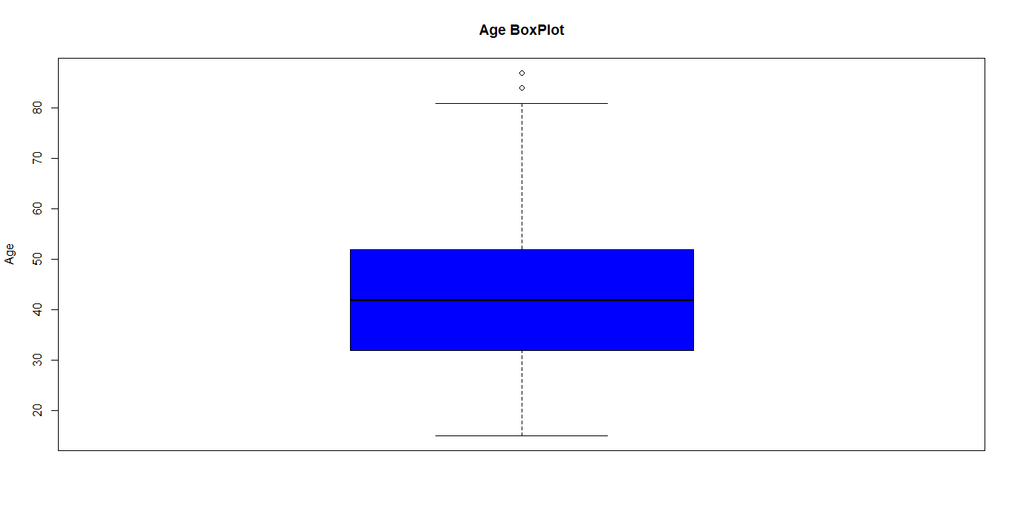
Phase 2 : Data Preparation(Cont.) Data Visualization
Get outliers of Age using Boxplot.
Mean age approximately 40 years old and outliers for age greater than 80 years old.

Slide 17
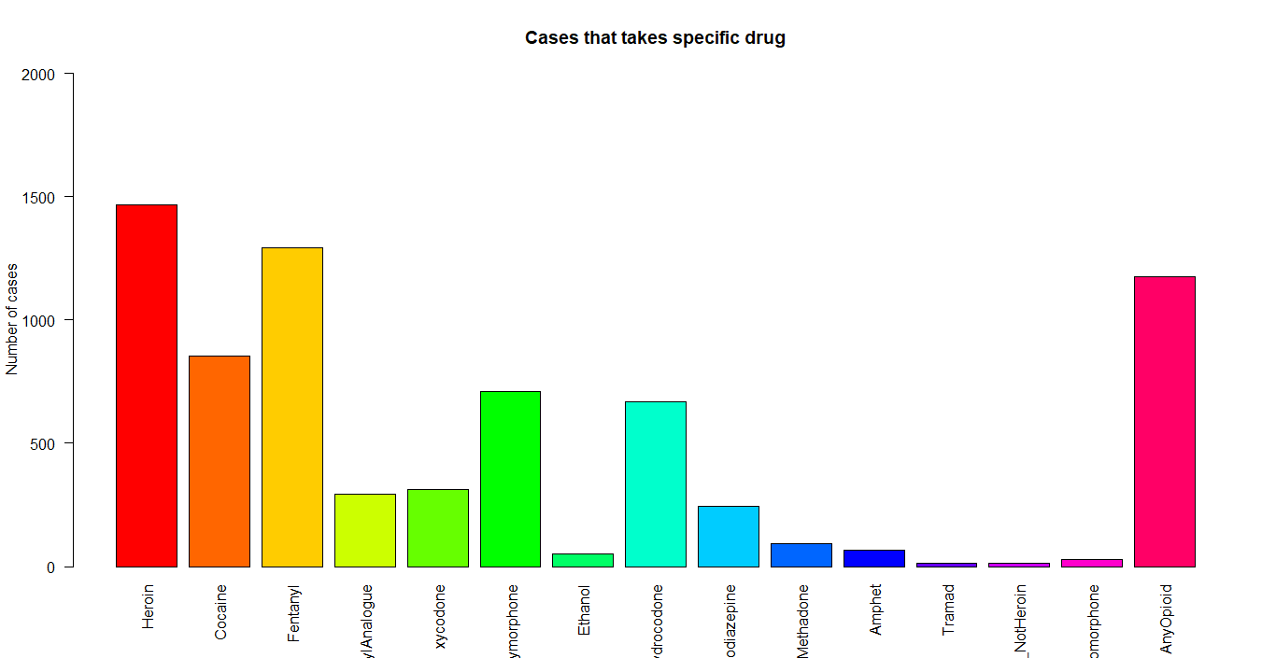
Phase 2 : Data Preparation(Cont.) Data Visualization
Determine the most common drug between males.
The most common drug between males is (Heroin).

Slide 18
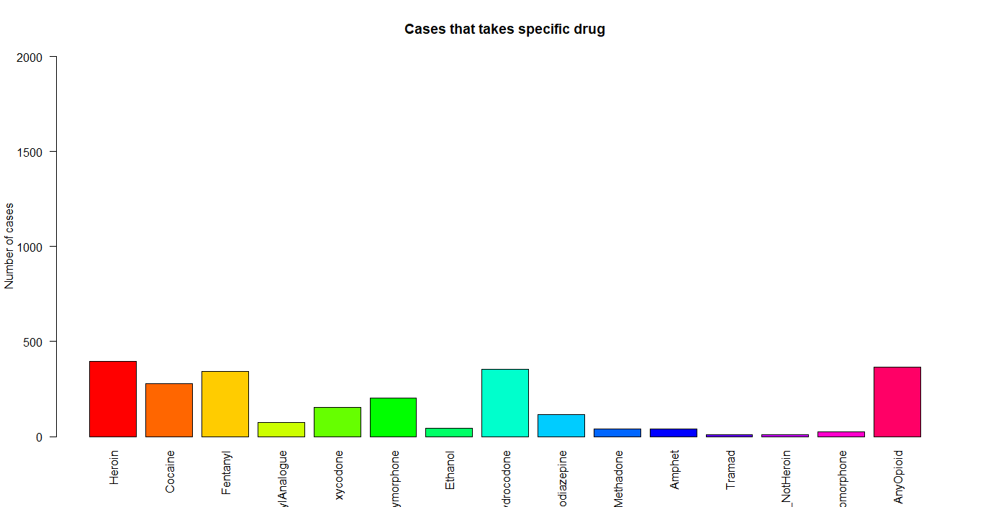
Phase 2 : Data Preparation(Cont.) Data Visualization
Determine the most common drug between Females.
The most common drug between females is (Heroin or any opioid).

Slide 19
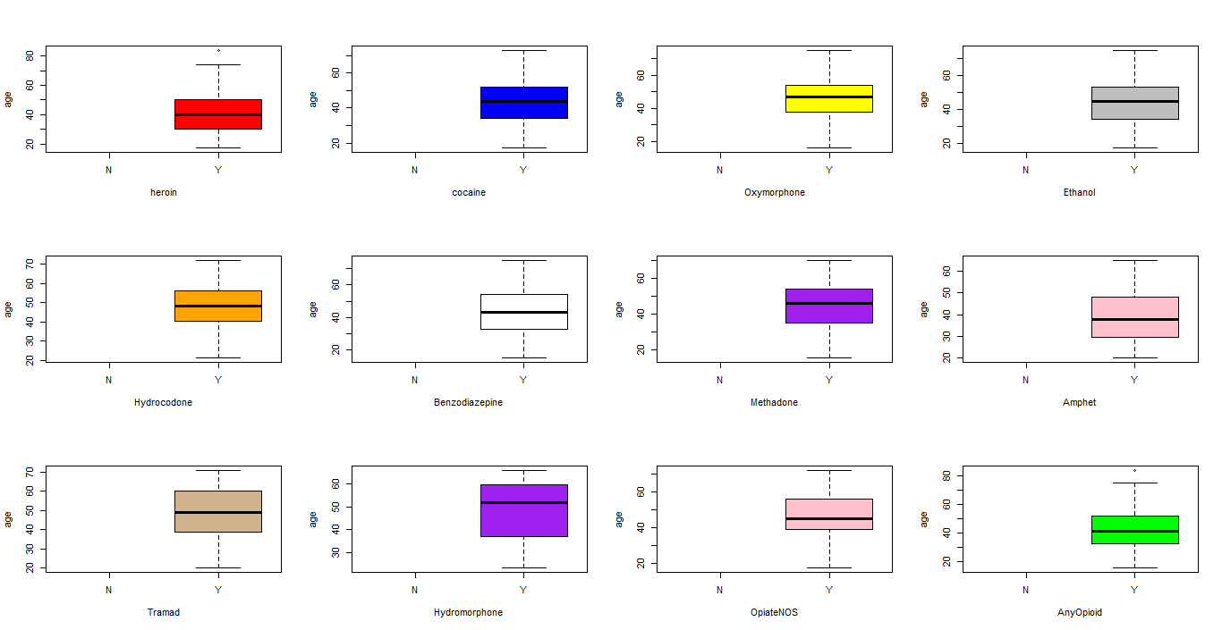
Phase 2 : Data Preparation(Cont.) Data Visualization
Determine median for age of people who take specific type of drug.

Slide 20
Phase 3 : Model Planning
Hypothesis
H0: Manner of death is accident.
H1: Manner of death is pending.
H2: Manner of death is natural.
Methods: Apriori and Naïve Bayesian classifier.
variables inter-dependencies
Manner of death depends of all other attributes.
Location if other depends on location.

Slide 21
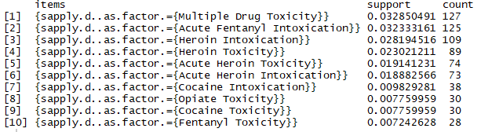
Phase 4 : Model Building
Apriori
Result
Observation: The most frequent COD is {Multiple Drug Toxicity} with support 0.032850491.

Slide 22

Phase 4 : Model Building(Cont.)
Naïve Bayesian classifier
Result
Accuracy: ((1156+2)/(1156+2+1+2))*100 = 99.74%.
Error rate: ((1+2)/(1156+2+1+2))*100 = 0.258%.

Slide 23
Phase 5 : Communicate Results
Interpret the results: Most people who take drugs die in accidents because of drugs.
Compare to IH’s from Phase 1: Initial hypnosis is not rejected.
Identify key findings:
People who are between ((30-35) , (47-52)) years old die because of accidents related to drugs.
The highest country that is resident count and death country at the same time is (HARTFORD).
The most used drug is (Heroin then Any Opioid).
The rest of findings in the documentation.

Slide 24
Phase 6 : Operationalize
Now we are able to classify people who die because of drugs and know manner of death for new given case and determine the most frequent drugs taken people in New England.
We discover that many people die in accidents because of drugs then doctors need to be able to focus on drug examination in case of accidents.

Slide 25
References
http://www.learnbymarketing.com/tutorials/naive-bayes-in-r/
https://tutorials.iq.harvard.edu/R/Rgraphics/Rgraphics.html
https://catalog.data.gov/dataset/accidental-drug-related-deaths-january-2012-sept-2015

